Slide 1

BASIC STATISTICS
Presented by Skillslash

Slide 2

Inferential statistic
With inferential statistics, you are trying to reach conclusions that extend beyond the immediate data alone. For instance, we use inferential statistics to try to infer from the sample data what the population
Inferential statistics can be contrasted with descriptive statistics. Descriptive statistics is solely concerned with properties of the observed data, and it does not rest on the assumption that the data come from a larger population.
A point estimate, i.e. a particular value that best approximates some parameter of interest;
an interval estimate, e.g. a confidence interval (or set estimate), i.e. an interval constructed using a dataset drawn from a population so that, under repeated sampling of such datasets, such intervals would contain the true parameter value with the probability at the stated confidence level;
www.skillslash.com

Slide 3
Hypothesis?
Hypothesis is a predictive statement, capable of being tested by scientific methods, that relates an independent variables to some dependent variable.
A hypothesis states what we are looking for and it is a proportion which can be put to a test to determine its validity
e.g.
Students who receive counseling will show a greater increase in creativity than students not receiving counseling
Average age of students in IIT is 70 year
Average weight of students in MIT is GE 60 Kg
www.skillslash.com

Slide 4
Intuition of Hypothesis Testing
Deepak’s Hypothesis: Average Age of people in ABC organization is 45 years
1 A sample of 20 people was picked and the sample statistics came out to be 49 years
How much doubt would that pose on my hypothesis?
2 A sample of 20 people was picked and the sample statistics came out to be 62 years
How much doubt would that pose on my hypothesis?
3 A sample of 2000 people was picked and the sample statistics came out to be 49 years
How much doubt would that pose on my hypothesis?
www.skillslash.com

Slide 5
Framing of Hypothesis
Null Hypothesis:
It is an assertion that we hold as true unless we have sufficient statistical evidence to conclude otherwise.
◆ Null Hypothesis is denoted by 𝐻0
◆ If a population mean is equal to hypothesised mean then Null Hypothesis can be written as
𝐻0: 𝜇 = 𝜇0
Alternative hypothesis
The Alternative hypothesis is negation of null hypothesis and is denoted by 𝐻_{𝑎}
If Null is given as 𝐻0: 𝜇 = 𝜇0
Then alternative Hypothesis can be written as
𝐻a: 𝜇 NE 𝜇0
www.skillslash.com

Slide 6
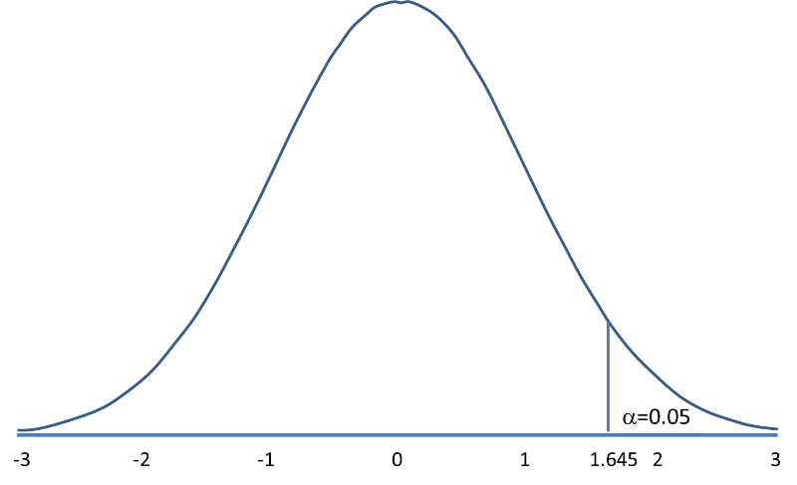
Level of significance and confidence
Significance means the percentage risk to reject a null hypothesis when it is true and it is denoted by 𝛼. Generally taken as 1%, 5%, 10%
(1 − 𝛼) is the confidence interval in which the null hypothesis will exist when it is true.
Alpha and 1-Alpha are Probability Values
Acceptance Region
Rejection Region/ Critical Region
www.skillslash.com

Slide 7
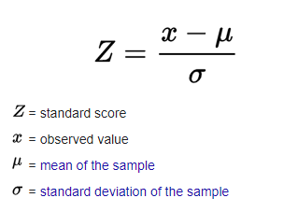
Critical value and Test statistics
Z-score (also called a standard score) gives you an idea of how far from the mean a data point is. We can calculate Z Statistics using the same, if distribution is normal
Acceptance Region
Rejection Region/ Critical Region
Z Score
Critical Value
www.skillslash.com

Slide 8
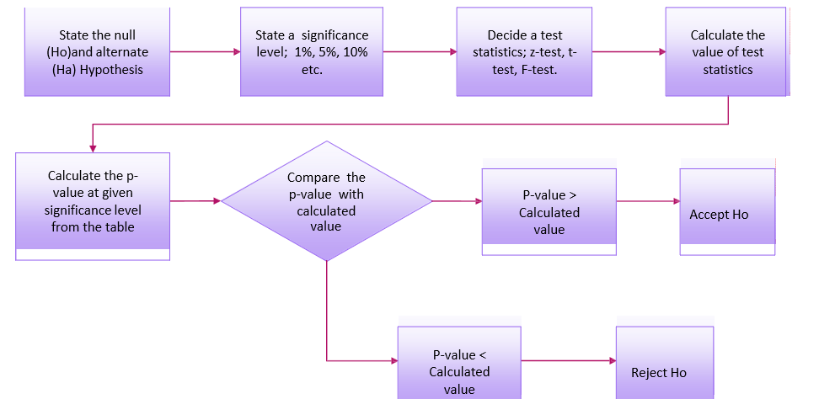
Overall Testing
www.skillslash.com

Slide 9
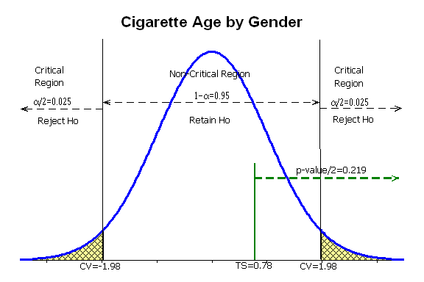
Two tail test
www.skillslash.com

Slide 10
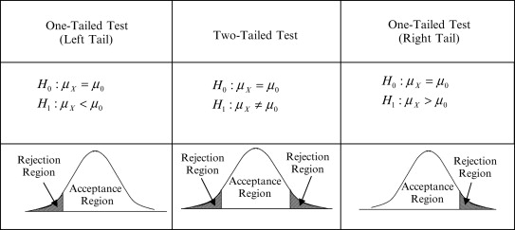
Different types of Tests
www.skillslash.com

Slide 11
Examples of Tests
www.skillslash.com

Slide 12
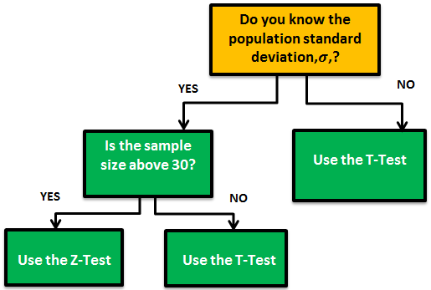
T Vs Z test
www.skillslash.com

Slide 13
Overall Testing
www.skillslash.com

Slide 14
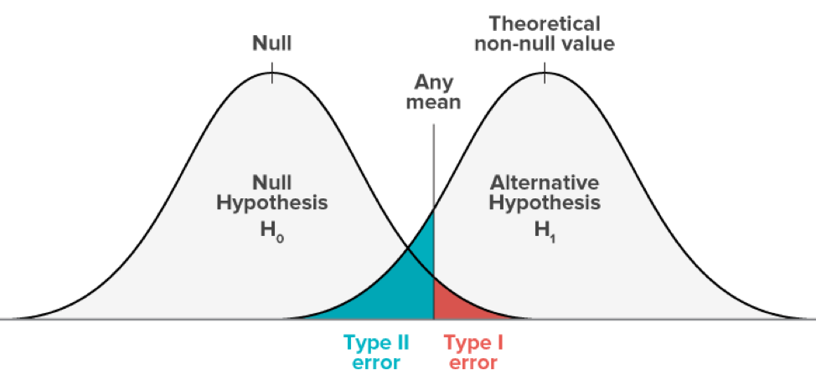
Type of errors in Hypothesis Testing

Slide 16
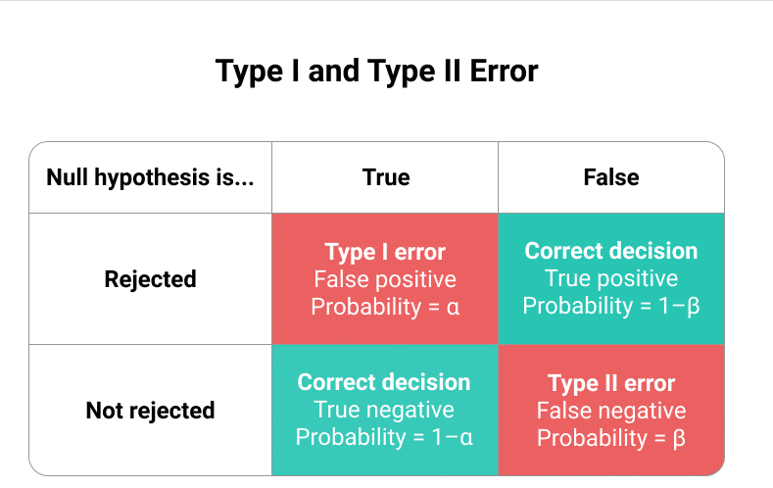
Type of errors in Hypothesis Testing
www.skillslash.com

Slide 17
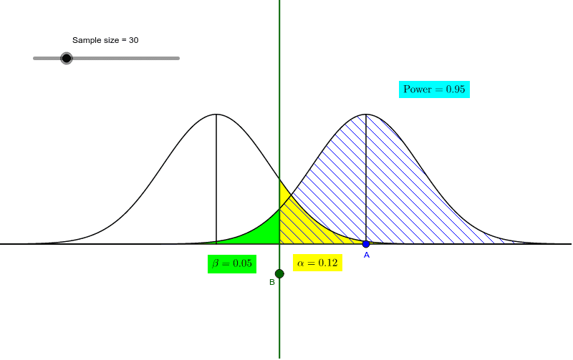
Power of test- Beta
Power: Reject H0 when it is false.
Detect the actual difference between samples
Power depends on the sample size, the magnitude of the expected effect, and the sample variance
www.skillslash.com

Slide 18
Example
Suppose a child psychologist says that the average time that working mothers spend talking to their children is at least 11 minutes per day. You want to test
You conduct a random sample of 100 working mothers and find they spend an average of 11.5 minutes per day talking with their children. Assume prior research suggests the population standard deviation is 2.3 minutes.
Conduct test with a level of significance of alpha=0.05

Slide 20
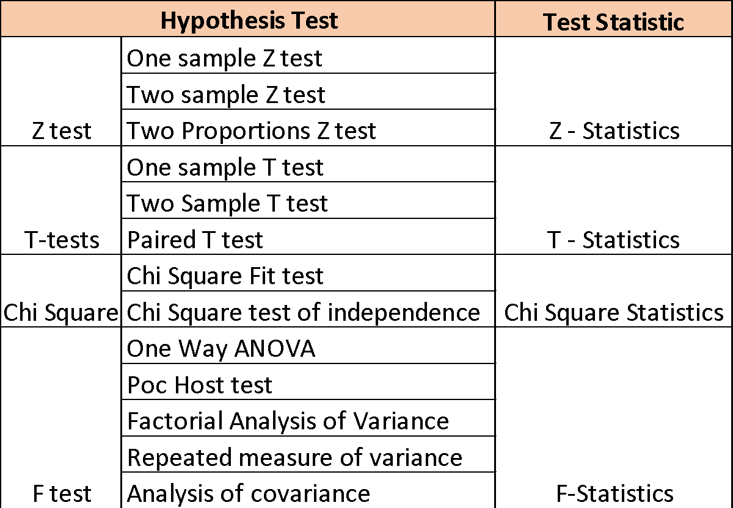
www.skillslash.com

Slide 21
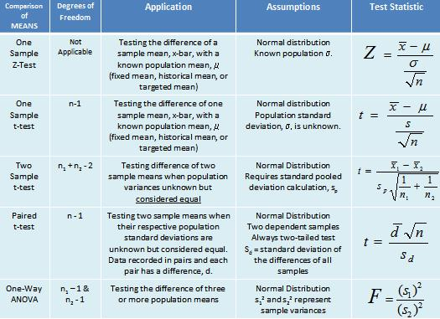
www.skillslash.com

Slide 22
Example-T Test
Suppose a child psychologist says that the average time that working mothers spend talking to their children is at-least 11 minutes per day. You want to test
You conduct a random sample of 20 working mothers and find they spend an average of 11.5 minutes per day talking with their children. Assume prior research suggests the population standard deviation is 2.3 minutes.
Conduct test with a level of significance of alpha=0.05

Slide 23
Two sample Test

Slide 24
A/B Testing

Slide 26
Chi-Square Testing

Slide 27
F Test & Annova Test

Slide 28
THANK YOU
www.skillslash.com

